Slide 1

Sponsorship Brochure
MastishkAbhati 2018, G.L.BAJAJ
20th and 21st April
MASTISHK ABHATI
WHERE CAREER AND PASSION COMES Together
CONTENTS
MASTISHK ABHATI
About ACM
Program Highlights
Sponsorships

Slide 2


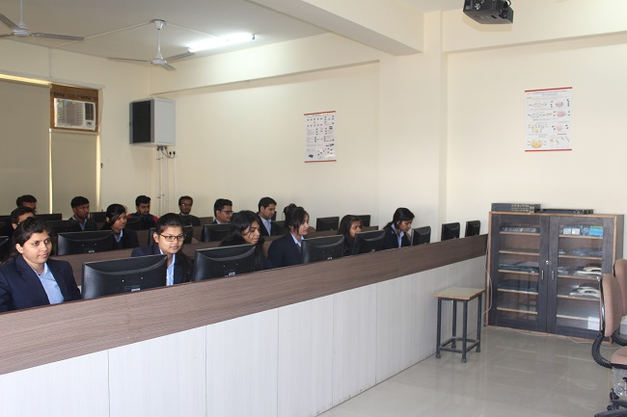
The Association for Computing Machinery (ACM) is an international learned society for computing. The ACM @ G. L. Bajaj Institute of Technology & Management, Greater Noida is the student chapter in G L Bajaj with its core focus areas in the field of computing, networking, education and technological innovations.
The student chapter is focused on a wide range of ACM activities like encouraging students to take an active interest in the emerging and exciting world of computing and facilitating the members by providing guidance in their field of interest.
ACM’s reach extends to every part of the globe, with more than half of its 100,000 members residing outside the U.S. GL Bajaj ACM Chapter was officially chartered by ACM's Chief Operating Officer on March 5, 2018. There are 20 student members and 5 professional members in the G.L. Bajaj ACM Student Chapter. GL Bajaj-ACM aims at conducting a series of Workshops, Events and Certification Programmes.
ACM has its Student Chapters spread all over the globe. The purpose of these chapters is to provide numerous opportunities among the student communities. The opportunities include development of leadership capabilities, career building, technical and professional growth, tours to develop contacts, utilization of technology to the fullest and others.

Slide 3
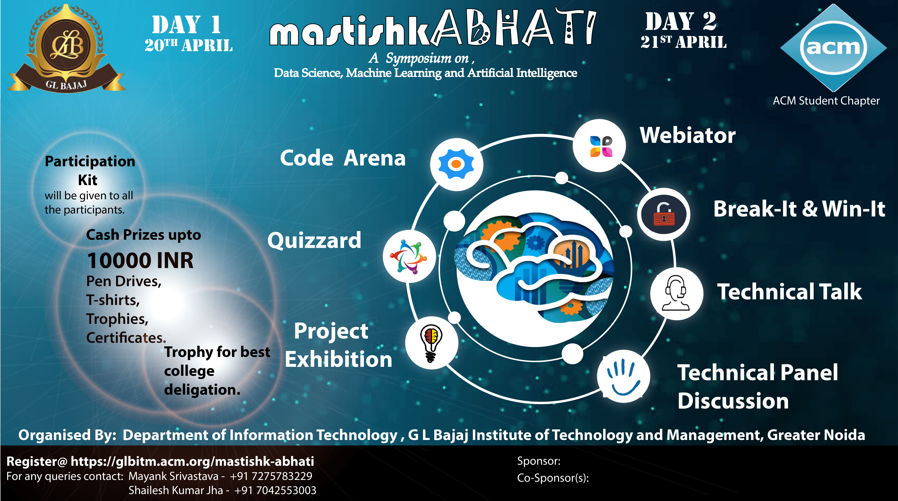
Mastishk-Abhati : ILLUMINATION OF MIND

Slide 4

Event Sponsorship
How can you contribute:
Our partners can opt for the role of either a lead or a Part Sponsor of the event. The estimated budget of every category is as mentioned below and the benefits of each sponsor are given in detail further:
SPONSORSHIP TIER | PLATINUM (30,000+) | GOLD (30,000-20,000) | SILVER (20,000-10,000) | BRONZE (Less than 10,000)
Discount coupon to top 20 of each event | 
Navigation to website | 
Logo on Reg. Desk |  |  |  | 
Logo on event poster |  |  | 
Stall in campus |  | 
Distribution of pamphlets |  | 
Pens & notepads |  | 
Logo on folder |  |  |  | 
Logo on t-shirts |  |  | 
Standee on gates | 8 | 6 | 4 | 2


Slide 5
Reg. post on facebook |  |  |  | 
Logo on face of exhibition table | 60% | 25% | 10% | 5%
Logo on participation certificates |  |  | 
Sponsors in kind:
Financial sponsors
In-kind sponsors :- In kind sponsors contribute goods or services rather than cash as their sponsorship offering.

Slide 6
Program Highlights
Day 2
21st April
Webiator
Break-It & Win-It
Technical talk
Technical Panel Discussion
Day 1
20th April
Code Arena
Quizzard
Project exhibition
As an effective platform for new ideas and fruitful collaborations, we at Team MastishkAbhati believes this offers our partners an excellent opportunity to reach out and communicate with a larger audience. We sincerely believe that your company will be well-represented in MastishkAbhati 2018, and hope that you will decide to partner with us.
For more information, please feel free to contact us, and our team will get back to you. Thanks for considering a partnership with G. L. Bajaj, Gr. Noida.

Slide 7

Contact Details:
MastishkAbhati Patron:
Mr. Pankaj Agarwal
MastishkAbhati Convenor:
Dr. Rajeev Agarwal
MastishkAbhati Coordinator:
Mr. Paras Bassi
Sponsorship Team:
Mr. Shivam kr. Singh
+91-8527713990
Ms. Soumya jain
+91-8588980106
Mr. Prabahakarn Singh
+91-8448622263
Amit Jaswal
+91-9818103453
Queries:
acmglbajaj@gmail.com
Venue partner
Organizing partner

